Slide 1
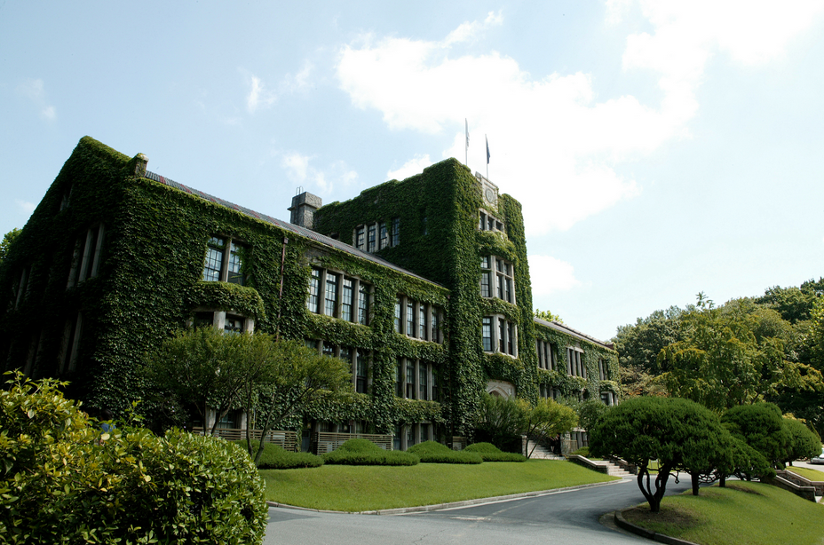
Church, State and Politics:
Cooperation or Protest?
Today’s Challenges in the Light of
Zürcher Reformation
Prof. Dr. Meehyun Chung
Yonsei University,Korea
May 11, 2019

Slide 2
Table of contents
Introduction
The legacy of the Swiss Reformation in Zürich
Karl Barth’s Theology as Revitalizing reformed legacy in 20th Century
How the Zwinglian heritage with a feminist twist connects to the global challenges of seeking justice
Some aspects of the Korean Church as a test case of sprout in the Reformed tradition
Conclusion

Slide 3
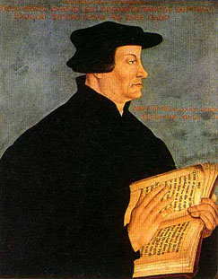
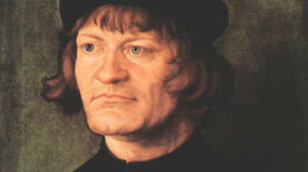
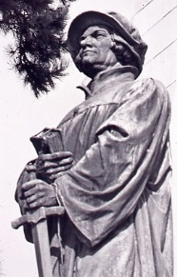
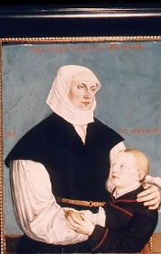
Huldreich Zwingli
(1484-1531)
Notes:
https://www.youtube.com/watch?v=gUadZFtVKds

Slide 4
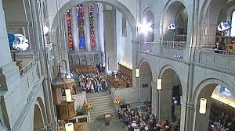
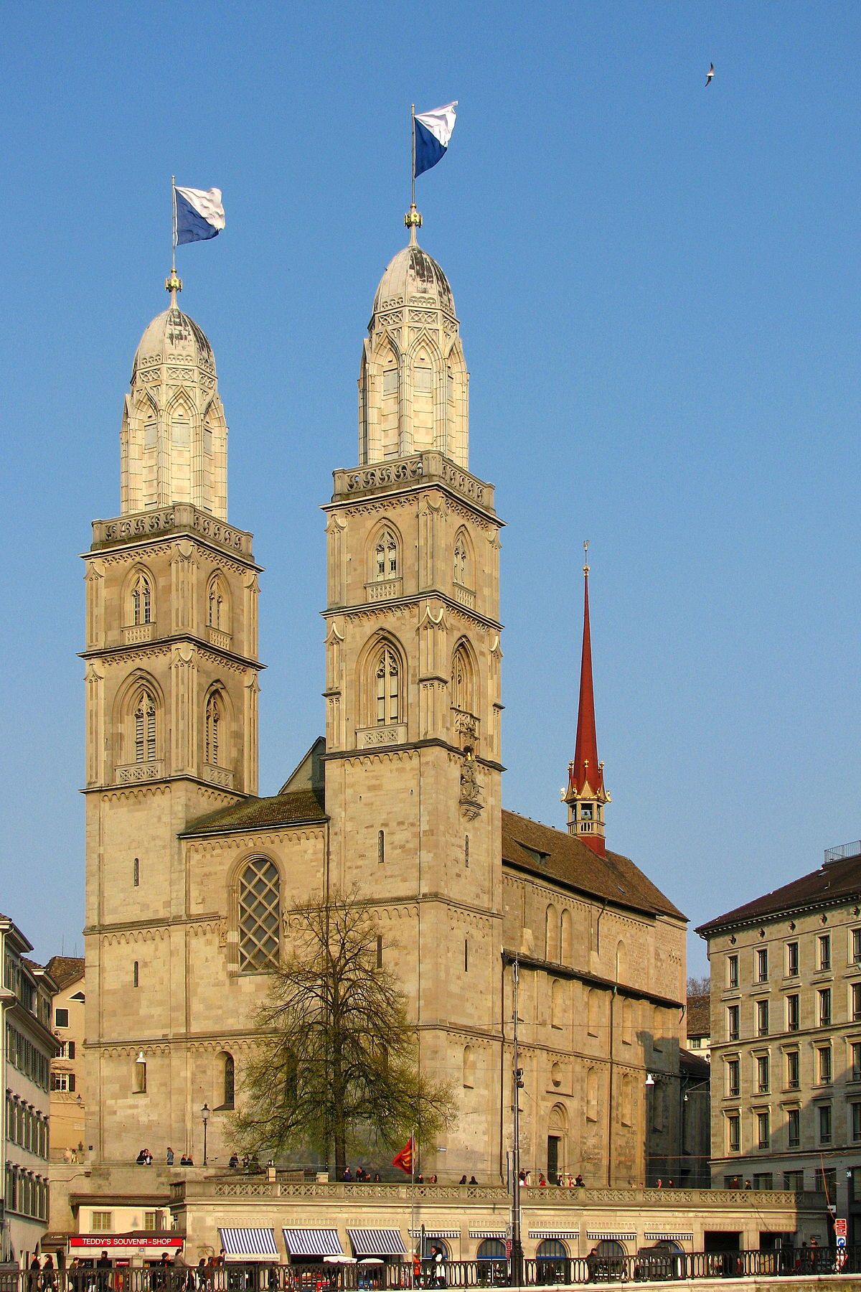
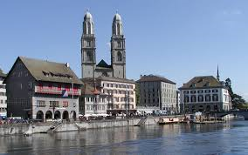
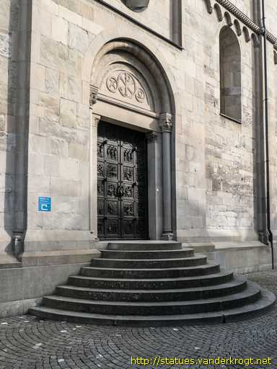

Slide 5
Zwingli(1484-1531) Luther(1483-1546)
1531
1534
Notes:
루터의 신약 번역 1522
츠빙글리의 신구약 전체 번역-루터보다 5년 빠름
신구약 성서 전체 인쇄본 츠빙글리1531-루터1534

Slide 6
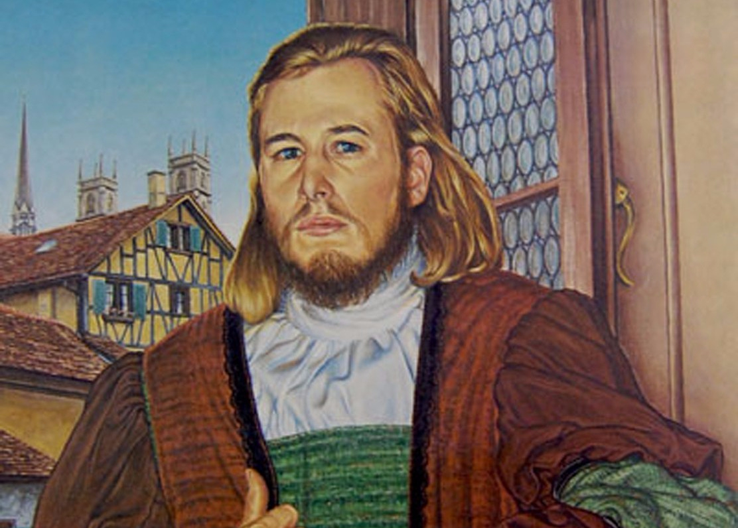
Anabaptist K. Grebel(1498-1526) F. Manz(1498-1527)

Slide 7
The Relationship between State and Religion
State & Christianity State Christianity State/Christianity
Integral Type Separate Type critical solidarity
(The city of God) (the theory of two kingdoms) (mutual control)

Slide 8
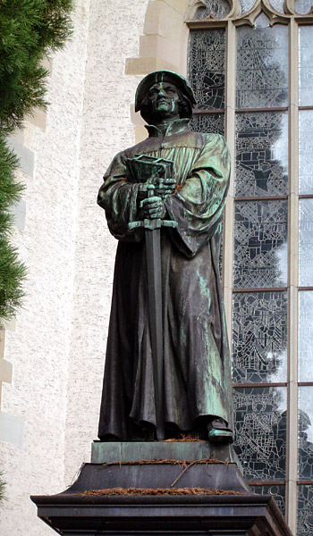
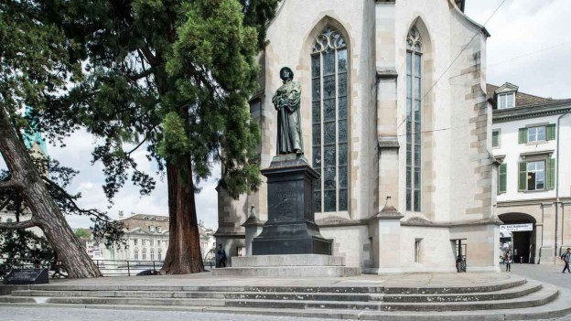

Slide 9
Schleitheim confession
Article 4: Separation from Evil
(membership of Christian community)
The community of Christians shall have no association with those who remain in disobedience and a spirit of rebellion against God. There can be no fellowship with the wicked in the world; there can be no participation in works, church services, meetings and civil affairs of those who live in contradiction to the commands of God (Catholics and Protestants). All evil must be resisted including their weapons of force such as the sword and armor.

Slide 10
Article 6: The Sword (nonresistance as Christian pacifism)
Violence must not be used in any circumstance. The way of nonviolence is patterned after the example of Christ who never exhibited violence in the face of persecution or as a punishment for sin. A Christian should not pass judgment in worldly disputes. It is not appropriate for a Christian to serve as a magistrate; a magistrate acts according to the rules of the world, not according to the rules of heaven; their weapons are worldly, but the weapons of a Christian are spiritual.

Slide 11
Article 7: The Oath
No (oaths) should be taken because Jesus prohibited the taking of oaths and swearing. Testifying is not the same thing as swearing. When a person bears testimony, they are testifying about the present, whether it be good or evil.

Slide 12
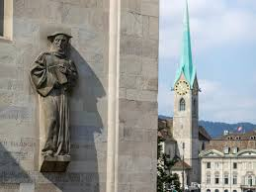
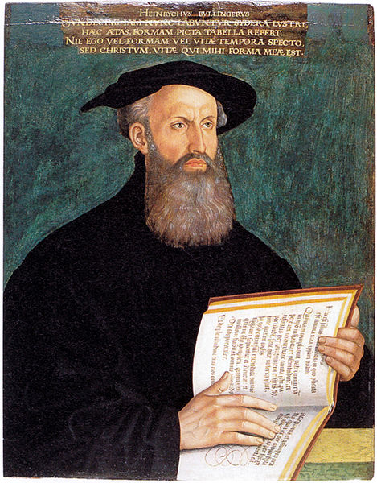
Heinrich Bullinger
(1504-1575)
Theology of Covenant

Slide 13
The Second Helvetic Confession: Article 30th
The chief duty of the magistrate is to secured and preserve peace and public tranquility. Doubtless he will never do this more successfully than when he is truly God-fearing and religious; that is to say, when, according to the example of the most holy kings and princes of the people of the Lord, he promotes the preaching of the truth and sincere faith, roots out lies and all superstition, together with all impiety and idolatry, and defends the Church of God. We certainly teach that the care of religion belongs especially to the holy magistrate.

Slide 14
Karl Barth with Rifle

Slide 15
Barmen 5
5. “Fear God. Honor the emperor.” (I Peter 2:17.) Scripture tells us that, in the as yet unredeemed world in which the church also exists, the State has by divine appointment the task of providing for justice and peace. [It fulfills this task] by means of the threat and exercise of force, according to the measure of human judgment and human ability. The church acknowledges the benefit of this divine appointment in gratitude and reverence before him. It calls to mind the Kingdom of God, God’s commandment and righteousness, and thereby the responsibility both of rulers and of the ruled. It trusts and obeys the power of the Word by which God upholds all things. https://www.ekd.de/en/The-Barmen-Declaration-303.htm

Slide 16
Korean context of division
Yongnim Kim

Slide 17
Cold War Between USA and Russia in Korea

Slide 18
Massacre in Korea: Pablo Picasso (1951)
https://en.wikipedia.org/w/index.php?curid=2612756

Slide 19
Peace in Korea (2017)
Woori Bank Art Contest for Children
Notes:
http://www.woorimisul.com/

Slide 20
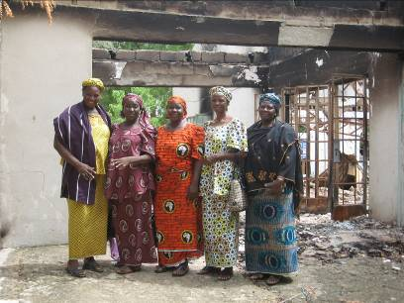
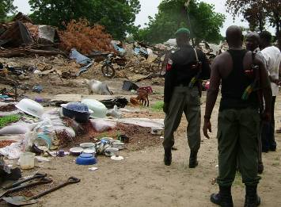
EYN Church in Nigeria
Trotz aller Schwierigkeiten
will die EYN nicht auf Hass und Vergeltung, sondern auf Heilung und Versöhnung setzen.
„Zum friedlichen Zusammenleben der Religionen gibt es keine Alternative.“

Slide 21
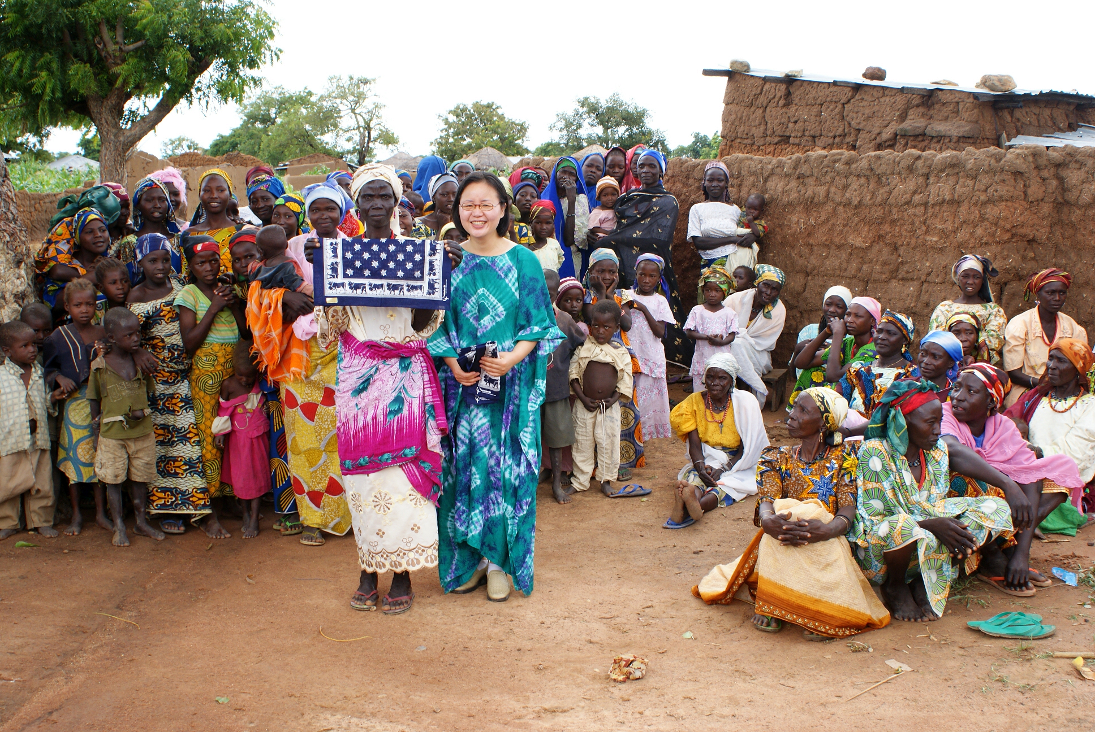

Slide 22
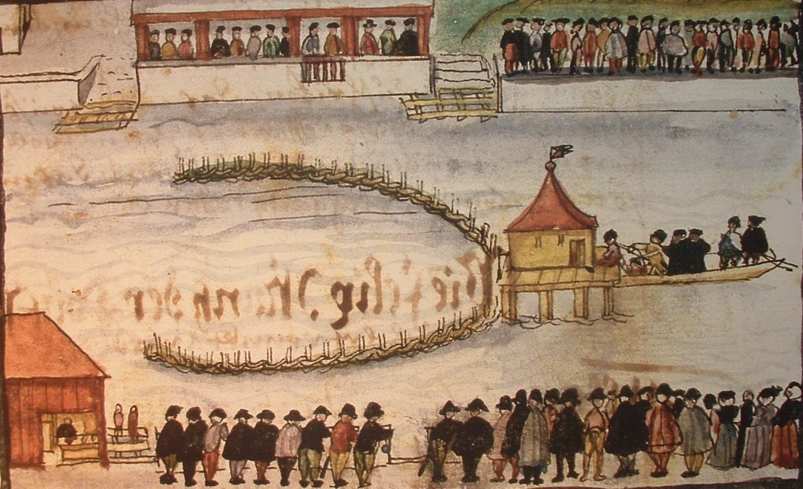
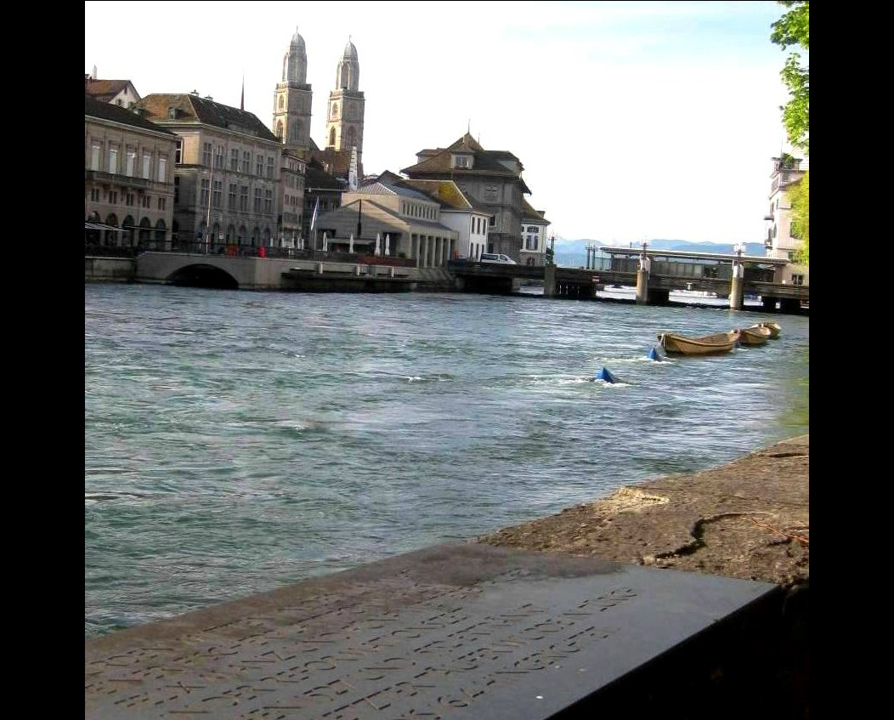
Reconciliation with Anabaptist

Slide 23
Toward Reconciliation and Peace

Slide 25
Thank you
for your attention

